Slide 1
Data Curation and Management Plans
SCHOOL OF ECONOMICS

Slide 2
Day three of Lecturers
Data Curation

Slide 3
Selection and Appraisal
A key question that comes up in the process of data curation and archiving is, which datasets are worthy of long-term retention?
There is the need to also understand the best criteria to use in making a choice in terms of data to accept and archive.
Making a choice on the data to archive would require you to answer the following questions.

Slide 4
Selection and Appraisal
Does the data fits into the mission and vision of the repository?
Does the data fits into the research focus of the institution?
What is the value of the data to the field (e.g. Social Sciences, Psychology, Medicine, Public Health etc.) of study the repository seek to archive its data?
How unique is the data and can it survive the test of time?
Is the data useful in terms of using current and emerging research and statistical techniques?

Slide 5
Selection and Appraisal
In addition to finding answers to the above question, any data repository or centre should also consider the following when making a decision on the kind of data to accept.
The diversity of the data
Preference should be given to complex data
Data arising from longitudinal research, survey research, and non-standard types: biological data, administrative records, video data, spatial data, remotely sensed data, and relational databases.

Slide 6
Selection and Appraisal
Data that uses the mixed method should also be given more preference
Data that can support both qualitative and quantitative analyses; data resulting from concurrent (both at the same time), sequential (one following the other), or conversion (one method to the other) mixed method study designs.
Data that is interdisciplinary in nature
Data from interdisciplinary studies, and data resulting from studies using the research methods of multiple disciplines.

Slide 7
Selection and Appraisal
Also the data should also meet the following additional criteria
The data are not available anywhere else, or are not likely to be available elsewhere in the future.
The data are in the public domain.
Copyright is clear, Copyright owners agree to your dissemination policies.
The dataset adheres to standards for privacy and confidentiality.
The technical documentation is complete.
The data are in a format that facilitates ease of use.

Slide 8
Receipt of Submission
Once data is submitted, there must be checks in place to validate the process of submission.
There should be systems in place to track the submission process.
You should be able to review the submission before making it available online.

Slide 9
Database Archiving
Data archiving is the process of moving data that may not be in active use to a dedicated storage device for long-term retention and possible future use.
Data archives mainly consist of old data that remains useful to organisations and researchers.
Data archives are indexed and have search capabilities.

Slide 10
Data Archiving (Purpose)
Data producers generate large amount of dataset on daily bases.
These datasets are captured in forms such as microdata from census and surveys, administrative record system, sample frame methodological and analytical reports.
These digital assets represent significant investment by producers and have considerable value for present and future users.

Slide 11
Data Archiving (Purpose)
Hence data archiving aids in the maximisation of invested resources in data production when there exist some form of expectation that they could be used in the future
It provides an ongoing access to cultural and historical heritage of a nation.

Slide 12
Roles in Data Archiving
There are three main roles in data archiving and one implicit role.
Producer
generates or is responsible for data to be preserved and provides the data to the archive or unit responsible for preservation.
Manager
has direct authority for the archive (or unit responsible for preserving data), specifically the approval of the budget and development of high level policy for preservation initiatives

Slide 13
Roles in Data Archiving
There are three main roles in data archiving and one implicit role.
Consumer
is authorised to use the data, either for internal purposes or general public use
The implicit role is the archive
The unit responsible for coordinating the archiving system as well as managing the content packages.

Slide 14
Good Practices for Data Archiving
Integrity Feature | Related Good Practice
Content: Ensures that essential elements of digital content are preserved | An organisation is expected to explicitly identify and actively manage data to be preserved
Fixity: requires that changes to content are recorded, ideally from the moment of creation onward | At minimum, this feature might be addressed through routine use of a checksum (a computed value generated by widely-available utilities that uniquely identify a digital file) to detect intentional or unintentional changes to data and notify data managers for action
Reference: ensures content is uniquely and specifically identifiable in relation to other content across time | For example, an organisation is required to adopt and maintain a persistent identifier approach – a system for assigning and managing enduring identifiers that allows digital objects to be consistently and uniquely referred to over time
Context: documents and manages relationships of digital content | An organisation that preserves data document relationships between its own digital content and, to the extent possible, to data managed by other organisations
Provenance: requires digital content be traceable to its origin (point of creation) or, at minimum, from deposit in a trusted digital repository | This feature requires that an organisation records information (captured as metadata) on the creation and action that have affected the content since its creation (e.g. data deposited in an archive, migrated from one file format to another)

Slide 15
Process of Data Archiving at C-DAMAA
The process of data archiving at C-DAMAA is based on the Inter-University Consortium for Political and Social Research (ICPSR) model for data archiving.
It summarises the processes of accepting, processing and putting the data out there for re-use.

Slide 16
Data Warehouse
A data warehouse is constructed by integrating data from multiple heterogeneous sources that support analytical reporting, and structured decision making.
Data warehousing involves data cleaning, data integration, and data consolidations.
A Data Warehouse works as a central repository where information arrives from one or more data sources.
Data flows into a data warehouse from the transactional system and other relational databases.
Notes:
The counterargument should be the most common argument against the topic. The goal for this slide is to address the counterargument in such a way as to actually strengthen the original topic. Be sure to address each piece of evidence against the topic. As you address each piece of evidence elaborate on the text found on the slide. Remember to transition to the final slide, the action step.

Slide 17
DATA WAREHOUSES
Data Warehouses:
Data spread in several databases –physically located at numerous sites
Data warehouse – repository of multiple DBs in single schema; resides at single site.
Data warehousing processes
Data Cleaning
Data Integration
Data Transformation
Data Loading
Periodic data refreshing
Notes:
The counterargument should be the most common argument against the topic. The goal for this slide is to address the counterargument in such a way as to actually strengthen the original topic. Be sure to address each piece of evidence against the topic. As you address each piece of evidence elaborate on the text found on the slide. Remember to transition to the final slide, the action step.

Slide 18
Data Source in Cape Coast
Data Warehouse
Client
Clean
Transform
Integrate
load
Query and Analysis Tools
Data Source in Accra
Data Source in Kumansi
Client

Slide 19
DATA WAREHOUSES
Data cleaning
Data Cleaning includes, filling in missing values, smoothing noisy data, identifying or removing outliers, and resolving inconsistencies.
Data integration
Data Integration includes integration of multiple databases, data cubes, or files.
Data transformation
Convert data from legacy or host format to warehouse format.
Notes:
The counterargument should be the most common argument against the topic. The goal for this slide is to address the counterargument in such a way as to actually strengthen the original topic. Be sure to address each piece of evidence against the topic. As you address each piece of evidence elaborate on the text found on the slide. Remember to transition to the final slide, the action step.

Slide 20
DATA WAREHOUSES
Load:
sort
summarize,
consolidate;
compute views;
check integrity.
Build indices and partitions.
Notes:
The counterargument should be the most common argument against the topic. The goal for this slide is to address the counterargument in such a way as to actually strengthen the original topic. Be sure to address each piece of evidence against the topic. As you address each piece of evidence elaborate on the text found on the slide. Remember to transition to the final slide, the action step.

Slide 21
DATA WAREHOUSES
Data in a data warehouse are organized around major subjects.
Data provide information on historical perspective – summarized on periodic dimension.
Eg. Sales of an item for a region in a period
Data warehouse model – multidimensional database structure / data cube
Dimensions – Attributes / set of attributes
Facts – Aggregated measures (Count /Sales amount)
Notes:
The counterargument should be the most common argument against the topic. The goal for this slide is to address the counterargument in such a way as to actually strengthen the original topic. Be sure to address each piece of evidence against the topic. As you address each piece of evidence elaborate on the text found on the slide. Remember to transition to the final slide, the action step.

Slide 22
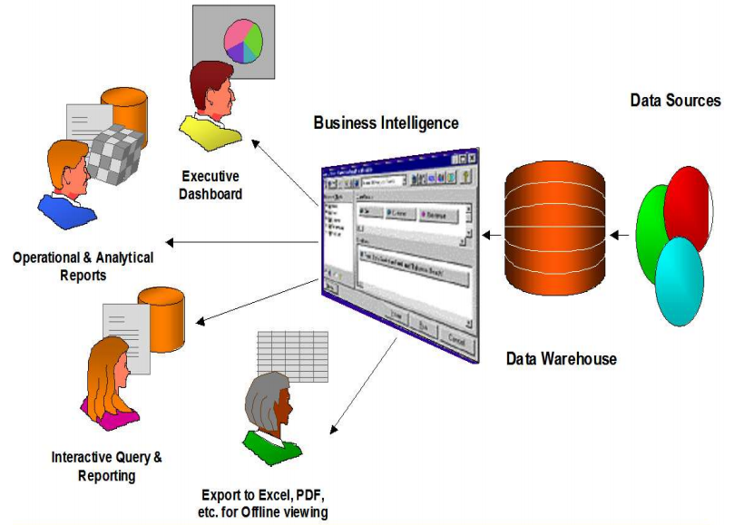
Components of a data warehouse
Sources –Data source interaction
Data Transformation
Data warehouse (data storage )
Reporting (Data presentation )
Metadata
Notes:
The counterargument should be the most common argument against the topic. The goal for this slide is to address the counterargument in such a way as to actually strengthen the original topic. Be sure to address each piece of evidence against the topic. As you address each piece of evidence elaborate on the text found on the slide. Remember to transition to the final slide, the action step.

Slide 23
Data Preprocessing
Why preprocess the data?
Data in the real world is dirty
incomplete: lacking attribute values, lacking certain attributes of interest, or containing only aggregate data
e.g., occupation=“”
noisy: containing errors or outliers
e.g., Salary=“-10”
inconsistent: containing discrepancies in codes or names
e.g., Age=“42” Birthday=“03/07/1997”
e.g., Was rating “1,2,3”, now rating “A, B, C”
e.g., discrepancy between duplicate records
Notes:
The counterargument should be the most common argument against the topic. The goal for this slide is to address the counterargument in such a way as to actually strengthen the original topic. Be sure to address each piece of evidence against the topic. As you address each piece of evidence elaborate on the text found on the slide. Remember to transition to the final slide, the action step.

Slide 24
Why Is Data Dirty?
Incomplete data comes from
n/a data value when collected
different consideration between the time when the data was collected and when it is analyzed.
human/hardware/software problems
Noisy data comes from the process of data
collection
entry
transmission
Inconsistent data comes from
Different data sources
Functional dependency violation

Slide 25
Major Tasks in Data Preprocessing
Data cleaning
Fill in missing values, smooth noisy data, identify or remove outliers, and resolve inconsistencies
Data integration
Integration of multiple databases, data cubes, or files
Data transformation
Normalization and aggregation
Data reduction
Obtains reduced representation in volume but produces the same or similar analytical results
Data discretization
Part of data reduction but with particular importance, especially for numerical data

Slide 26
Data Cleaning
Importance
“Data cleaning is one of the three biggest problems in data warehousing”—Ralph Kimball
“Data cleaning is the number one problem in data warehousing”—DCI survey
Data cleaning tasks
Fill in missing values
Identify outliers and smooth out noisy data
Correct inconsistent data
Resolve redundancy caused by data integration

